Slide 1
Rearranging Acceleration Equation and teach examples

Slide 2
Learning Objectives
I can mathematically rearrange the acceleration equation.
I can calculate acceleration using the formula.
Notes:
In this lesson, students will learn the definitions of both potential and kinetic energy. They will also be able to give examples of each and explain how potential energy changes into kinetic energy.

Slide 3
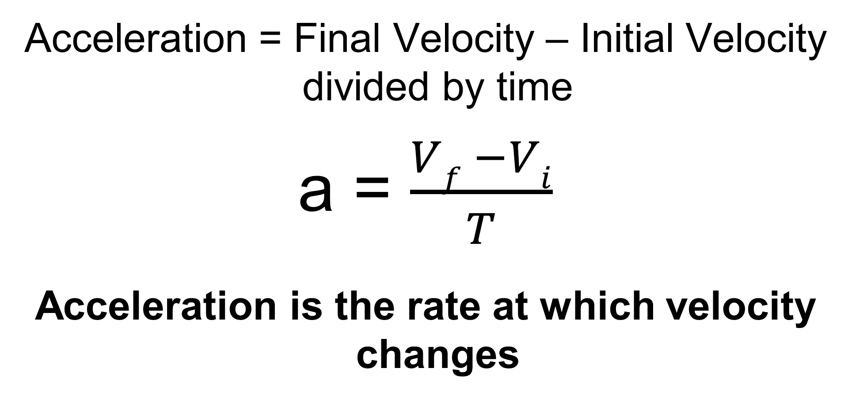
Calculating Acceleration
Acceleration = Final Velocity – Initial Velocity divided by time
a = $\frac{Vf −Vi}{T}$
Acceleration is the rate at which velocity changes

Slide 4
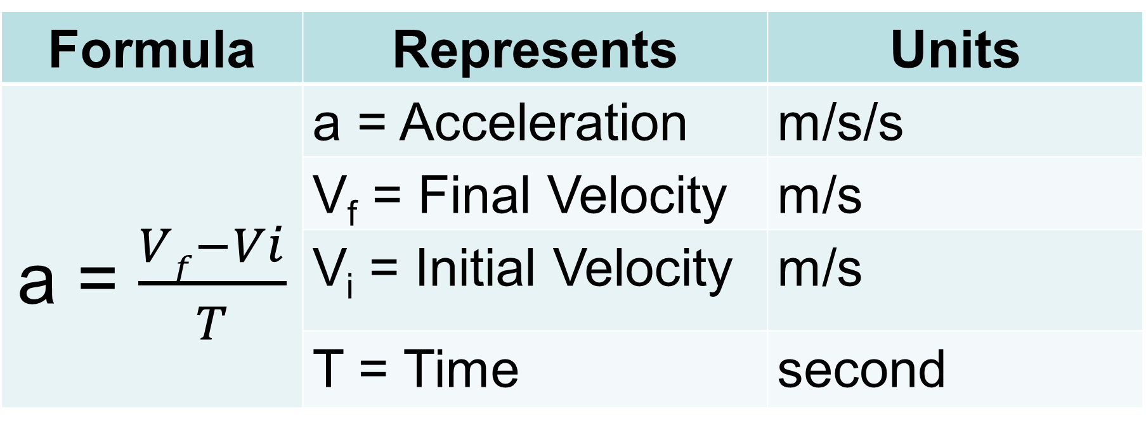
Formula Representation
Formula | Represents | Units
a = $\frac{Vf−Vi}{T}$ | a = Acceleration | m/s/s
 | V_{f} = Final Velocity | m/s
PE = mgh | V_{i} = Initial Velocity | m/s
 | T = Time | second
mass

Slide 5
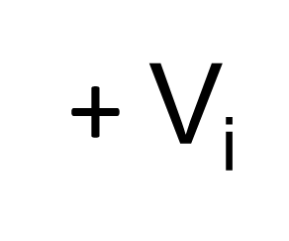

Solve for Final Velocity (V_{f})
(t)
Step 1 – Multiply both sides by t – time
Step 2 – add V_{i} – initial velocity to both sides
a = $\frac{Vf−Vi}{T}$
V_{f} = at + V_{i}
(t)
at = V_{f} - V_{i}
+V_{i}

Slide 6

Solve for Initial Velocity (V_{i})
(t)
Step 1 – Multiply both sides by t – time
Step 2 – add Vi – initial velocity to both sides
Step 3 – subtract- at from both sides
a = $\frac{Vf−Vi}{T}$
(t)
at = V_{f} - V_{i}
+V_{i}
-at
-at
V_{f} = V_{i} + at
V_{i} = V_{f} - at

Slide 7


Solve for Time (t)
(t)
Step 1 – Multiply both sides by t – time
Step 2 – Divide by a – acceleration on both sides
a = $\frac{Vf−Vi}{T}$
(t)
at = V_{f} - V_{i}
__
a
______
a
t = $\frac{Vf−Vi}{a}$

Slide 8
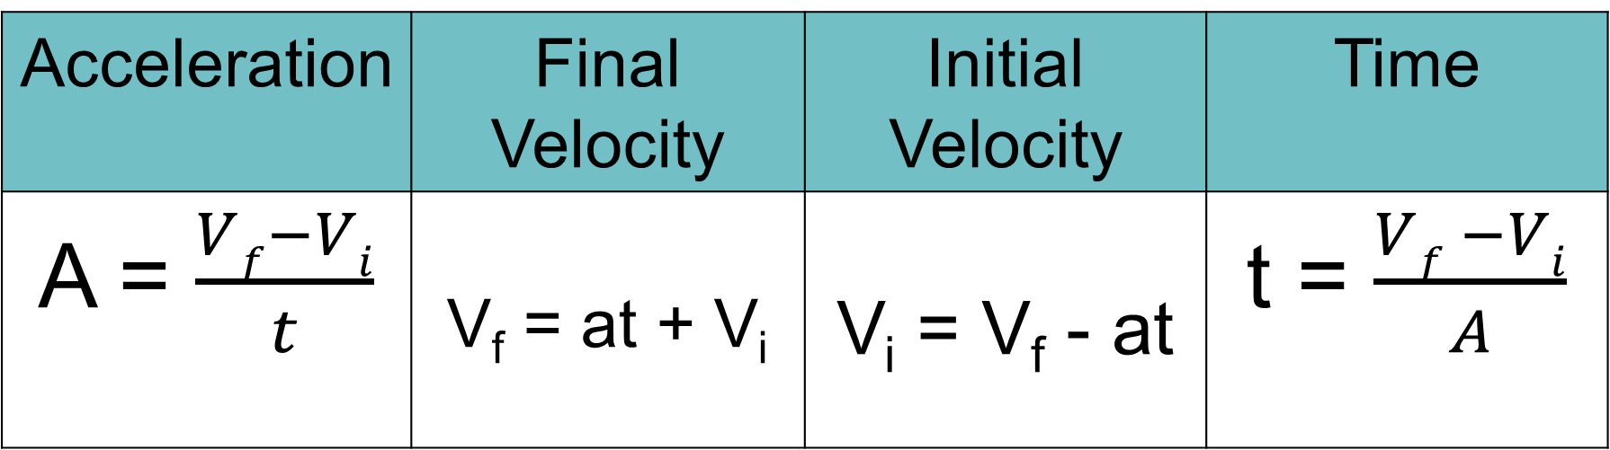
Acceleration Related Equations
Acceleration | Final Velocity | Initial Velocity | Time
A = $\frac{Vf−Vi}{t}$ | V_{f} = at + V_{i} | V_{i} = V_{f} - at | t = $\frac{Vf −Vi}{A}$

Slide 9

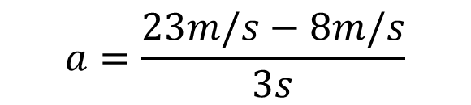

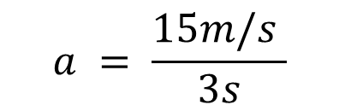
Calculation Example #1
1. The wind is blowing with a velocity of 8m/s W. Suddenly, in 3s, the wind’s velocity is 23m/s W. What is the acceleration?
Given/ Unknown | Work
A = Vf = Vi = t =
?
23m/s
$$a=\frac{23m/s−8m/s}{3s}$$
$$a = \frac{15m/s }{3s}$$
$$a=\frac{{v_{f}−v}_{i}}{t}$$
$$a=5m/s/s$$
8m/s
3s

Slide 10




Calculation Example #2
2. The acceleration of the car is 8m/s/s. The car passes over point A with a velocity of 30m/s S. What will the car’s final velocity be after 5s?
Given/ Unknown | Work
A = Vf = Vi = t =
8m/s/s
$$V_{f}=at+V_{i }$$
$V_{f}$ $=8m/s/s\left(5s\right)+30m/s$
?
30m/s
$V_{f}$ $=40m/s+30m/s$
$$V_{f}=70 m/s$$
5s

Slide 11

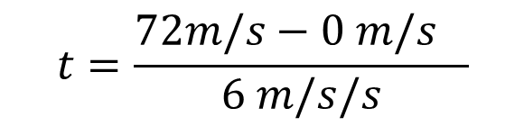


Calculation Example #3
3. A train travels at an acceleration of 6m/s/s, starting from a standstill at a station and traveling along a straight track. How long does it take the train to reach 72m/s?
Given/ Unknown | Work
A = Vf = Vi = t =
6m/s/s
72m/s
$$t=\frac{{72m/s−0 m/s}_{}}{6 m/s/s}$$
$$t=\frac{{72m/s}_{}}{6 m/s/s}$$
$$t=\frac{{v_{f}−v}_{i}}{a}$$
$$t=12 s$$
0m/s
?

